Slide 1
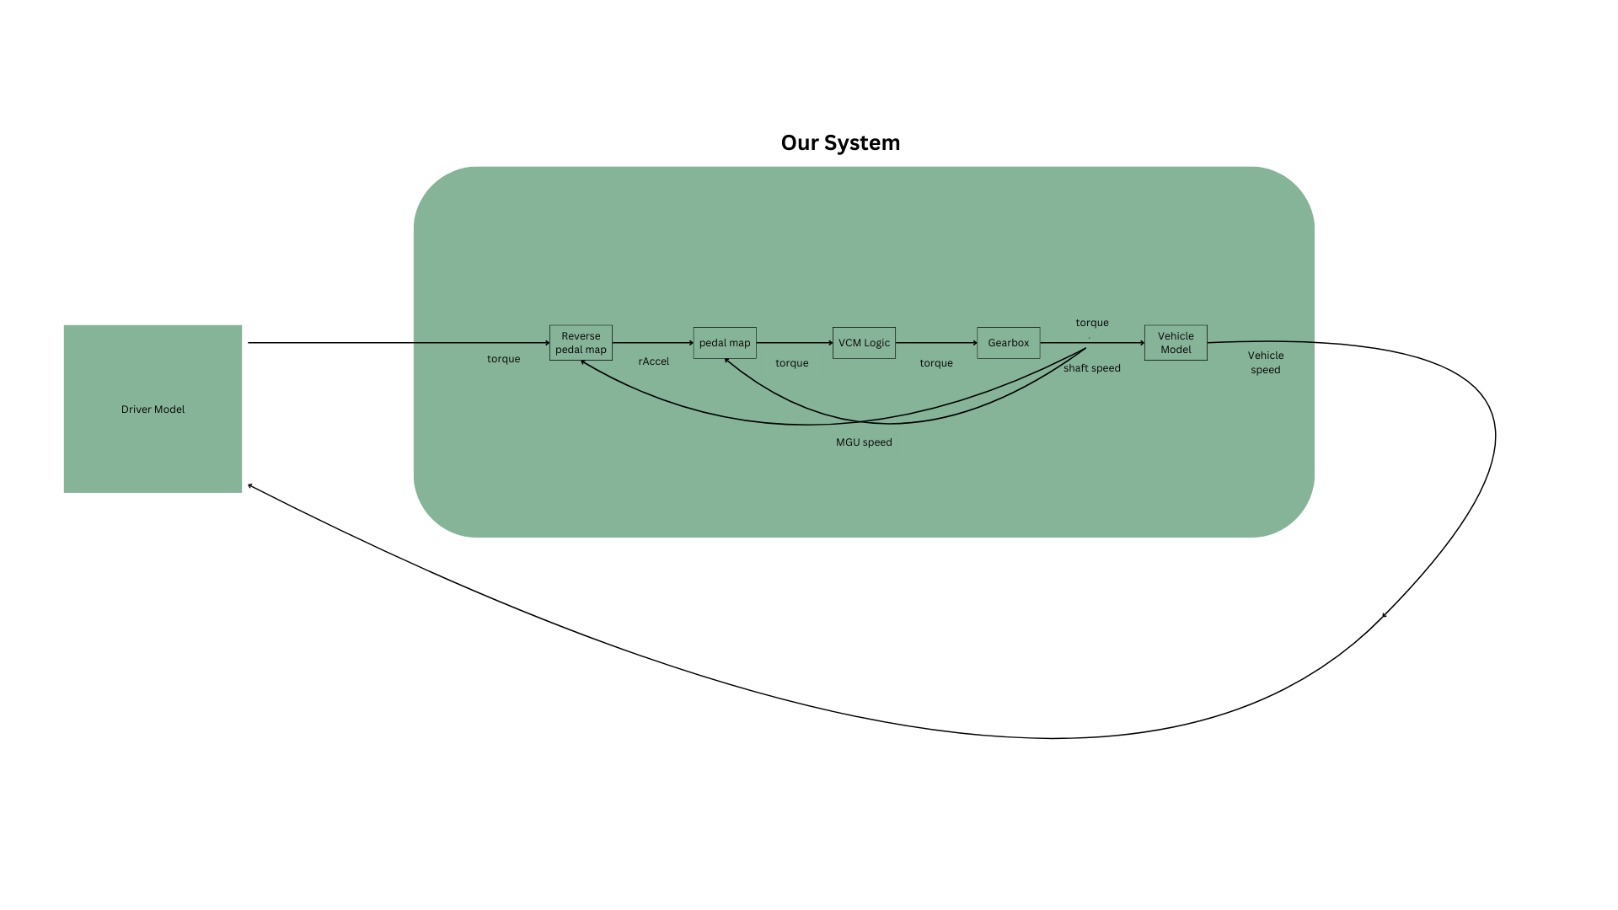

Slide 2
DiL
Pedal Demand % / Bar (Brake Pressure)

Slide 3
Our Local Machine (For Testing Purpose)
nMGU
Pedal Demand % / Bar (Brake Pressure)

